Slide 1
COMPUTER VISION-I
DIGITAL IMAGE PROCESSING
Marya Butt, PhD.
Researcher Data Driven Smart Society (DDSS)
BIG DATA, Computer Vision, Machine Learning
Faculty of Engineering Design and Computing
Mob: +31(0) 0611878759
E: marya.butt@Inholland.nl
Working days: mo, tu, we and thu.

Slide 2
Weekly Schedule
Session 1: Introduction to Digital Image Processing (DIP)
Session 2: Keras and TensorFlow-I(using FC NN for Regression)
Session 3: Keras and TensorFlow -II(using FC NN for Classification)
Session 4: Hyperparameter Tuning (using Keras Tuner)
Session 5: Convolution Neural Networks-I
Session 6: Convolution Neural Networks-II (Visualizing Filters and Feature Maps)

Slide 3
Computer Vision-I Exam
40 MCQs (40 Points)
4 Open Questions (60 Points)
Assignment
Status: Mandatory
10 Bonus Points

Slide 4
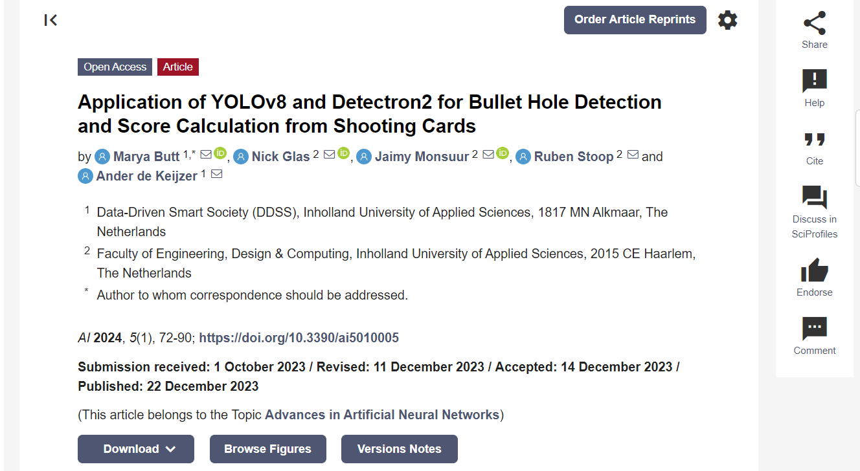
AI | Free Full-Text | Application of YOLOv8 and Detectron2 for Bullet Hole Detection and Score Calculation from Shooting Cards (mdpi.com)

Slide 5
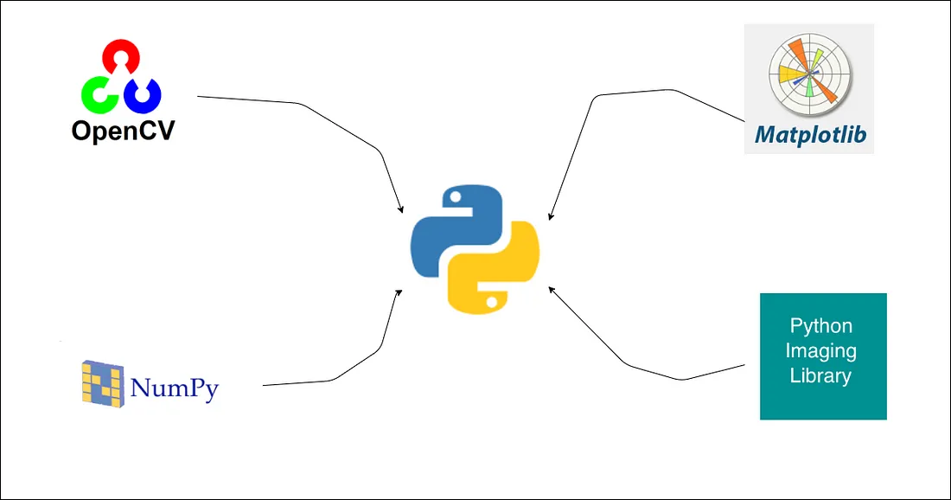
Python Libraries (Image Processing)

Slide 6
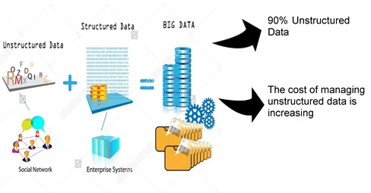
Big Data & Types
Structured Data (10%)
Data stored in rows and columns
Numerical
Unstructured Data (90%)
Image
Video
Document

Slide 7
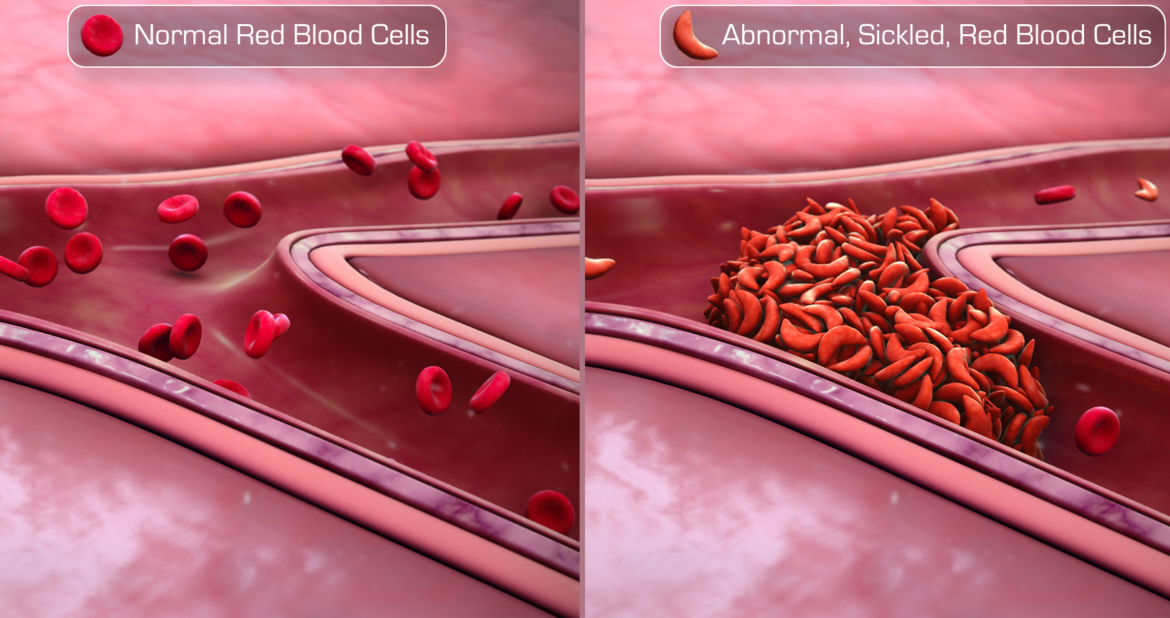
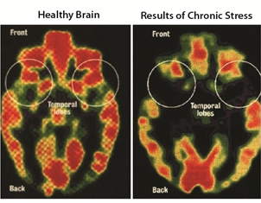
Why do we need Digital Images?
A picture is worth a thousand words!

Slide 8
Why do we process Images?
Digital image processing focuses on two major tasks
Improvement of pictorial information for human interpretation
Processing of image data for storage, transmission and representation for autonomous machine perception
Image data needs to be analyzed automatically
Reduce the burden of human operators by teaching a computer to see
Enhance and restore images
Remove scratches from an old movie, Improve visibility of tumor in a radiograph
Extract information from images
Read the ZIP code on a letter

Slide 9

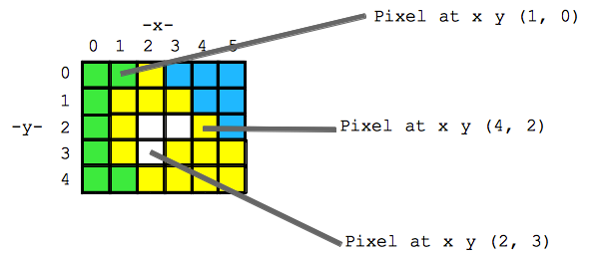
Digital Image? Two-dimensional array of numbers f(x,y)
Grayscale images, 8-bit data value (with a range of 0 to 255) or a 16-bit data value (with a range of 0 to 65535).
Color images, 8-bit, 16-bit, 24- bit, and 30-bit colors

Slide 10
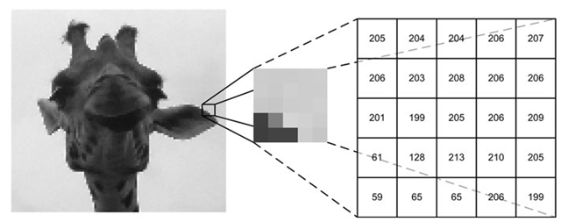
Guess!

Slide 11
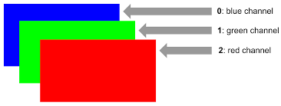
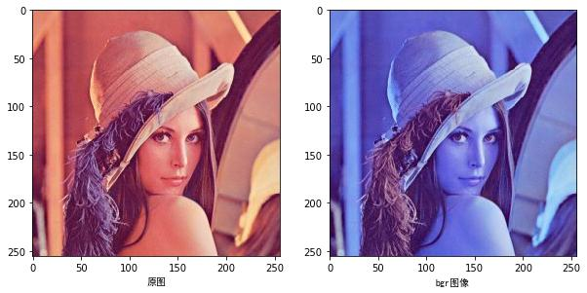
Image Processing RGB Vs BGR
from skimage import io >>> moon = io.imread(filename)

Slide 12
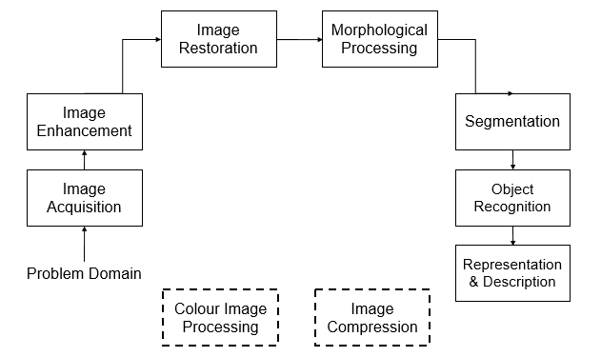
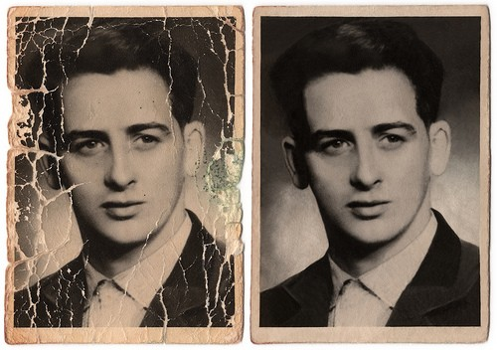
Image Processing Phases

Slide 13
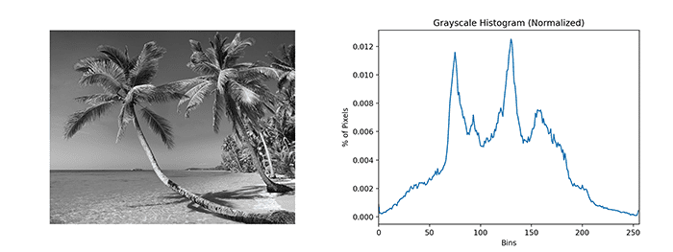
Image Enhancement
Histogram Equalization
Histogram equalization is a basic image processing technique that can improve an image’s overall contrast.
Applying histogram equalization starts by computing the histogram of pixel intensities in an input grayscale/single-channel image:

Slide 14
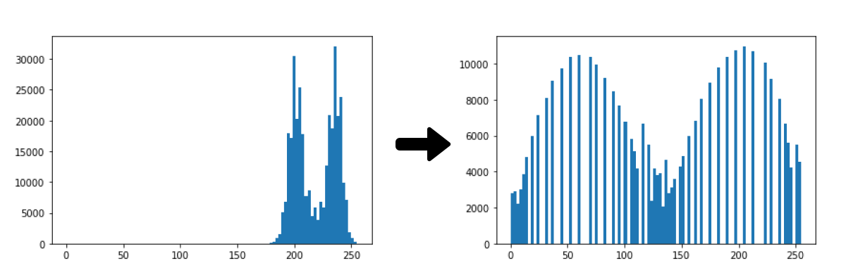
Image Enhancement
Histogram Equalization
Process of streching the pixel values across the entire range from 0-255

Slide 15
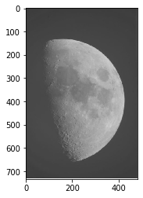
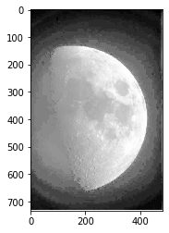
Image Enhancement
Histogram Equalization
Process of streching the pixel values across the entire range from 0-255

Slide 16
“Is it possible to improve image contrast without also boosting noise at the same time?”
The answer is “Yes,” you just need to apply adaptive histogram equalization.

Slide 17
Image Enhancement
CLAHE
(Contrast Limited Adaptive Histogram Equalization)
With adaptive histogram equalization, we divide an input image into an M x N grid. We then apply equalization to each cell in the grid, resulting in a higher quality output image.
Performing adaptive histogram equalization requires:
Convert the input image to grayscale/extract a single channel from it
Instantiate the CLAHE algorithm using cv2.createCLAHE
Call the .apply method on the CLAHE object to apply histogram equalization.

Slide 18
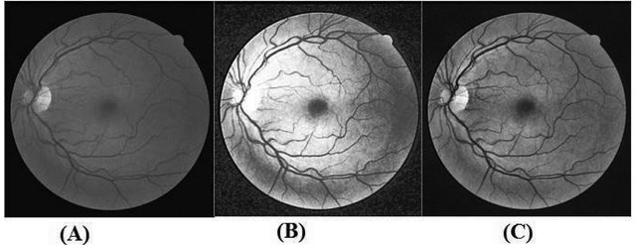
Image Enhancement
CLAHE (Contrast Limited Adaptive Histogram Equalization)
Figure 6. (A) Green Channel, (B) after histogram equalization, (C) after CLAHE.

Slide 19
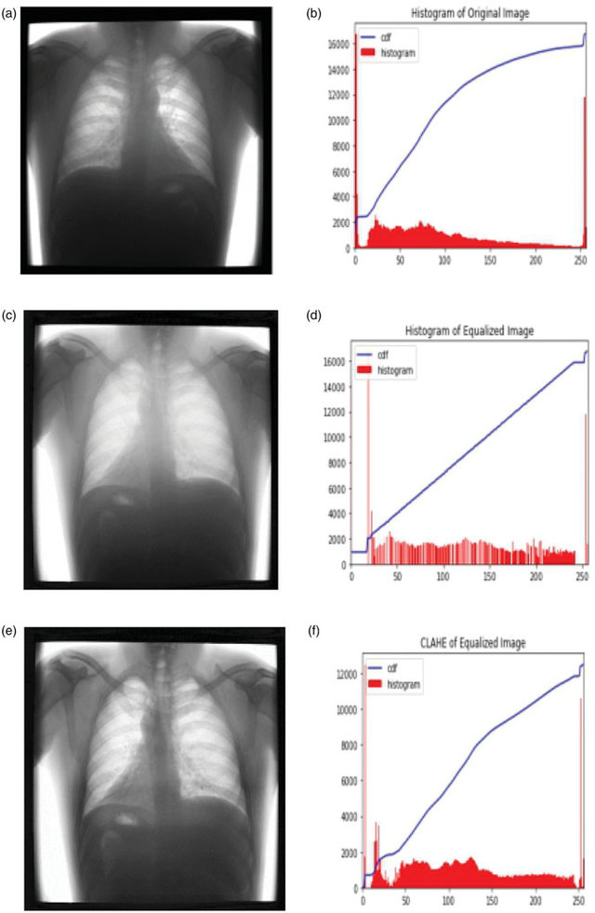
Image Enhancement
CLAHE
Applications

Slide 20
Multiresolution Processing
process of representing images in various degrees of resolution
The big question with resolution is always how much is enough?
This all depends on what is in the image and what you would like to do with it
Key questions include
Does the image look aesthetically pleasing?
Can you see what you need to see within the image

Slide 21
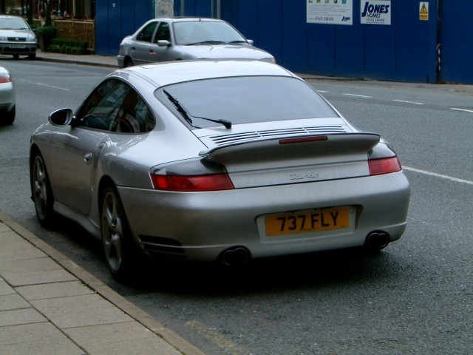

Image Resolution
The picture on the right is fine for counting the number of cars, but not for reading the number plate

Slide 22
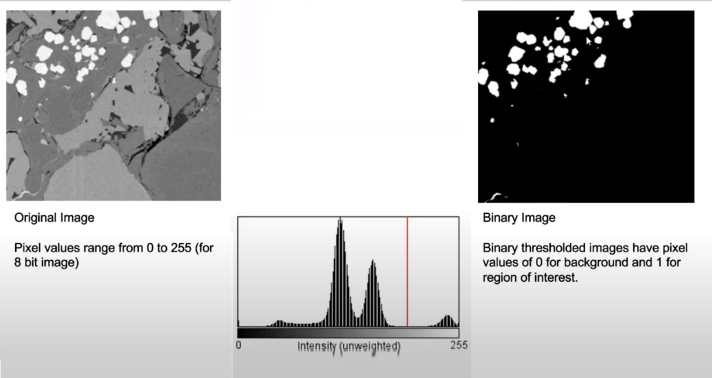
Image Binarization
Source:Apeer.com

Slide 23
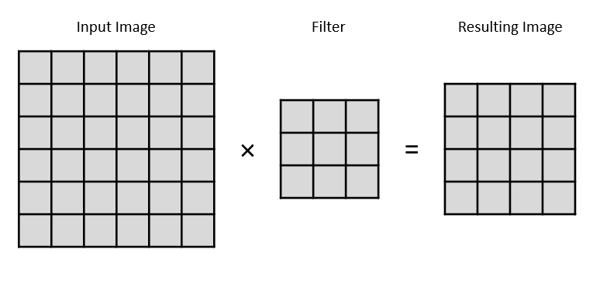
Image Processing Filter Vs Kernel
from skimage import io >>> moon = io.imread(filename)
A filter is a concatenation of multiple kernels, each kernel assigned to a particular channel of the input.

Slide 24
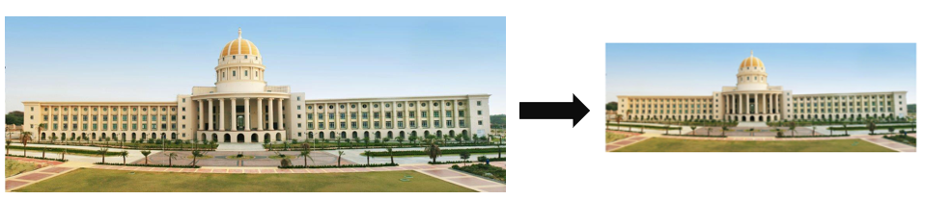
Compression
Reducing the size of the image with minimum deterioration in its quality (image shrinkage)
For Expansion:
img_scaled = cv2.resize(img,None,fx=1.2, fy=1.2, interpolation = cv2.INTER_LINEAR)
cv2_imshow(img_scaled)
For compression:
img_scaled = cv2.resize(img,(450, 400), interpolation = cv2.INTER_AREA)
cv2_imshow(img_scaled)
OpenCV provides a function called resize to achieve image scaling. If you don't specify a size (by using None), then it expects the X and Y scaling factors. In our example, the image will be enlarged by a factor of 1.2.

Slide 25
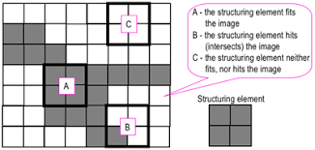
Morphological Processing (Erosion & Dilation) Morphological image processing is a collection of non-linear operations related to the shape or morphology of features in an image
Morphological techniques probe an image with a small shape or template called a structuring element. The structuring element is positioned at all possible locations in the image and it is compared with the corresponding neighbourhood of pixels. Some operations test whether the element "fits" within the neighbourhood, while others test whether it "hits" or intersects the neighbourhood

Slide 26

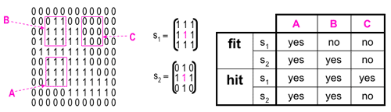
Morphological Processing (Erosion & Dilation)

Slide 27
Morphological Processing (Erosion & Dilation) How to erode and dilate in python?
# Create structure element Kernel
kernel = np.ones((3, 3), np.uint8)
# Instantiate erode and dilate function
img_erosion = cv2.erode(img, kernel, iterations=1)
img_dilation = cv2.dilate(img, kernel, iterations=1)
# display results
cv2_imshow(img)
cv2_imshow(img_erosion)
cv2_imshow(img_dilation)
cv2.waitKey(0)

Slide 28
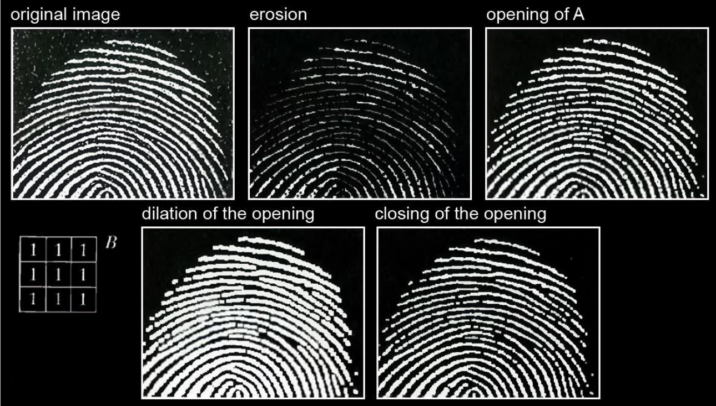
Morphological Processing (Opening & Closing)
Opening= Erosion + Dilation
Closing= Dilation + Erosion
Notes:
Image Source: MorphologicalImageProcessing.pdf

Slide 29
Morphological Processing (Opening & Closing)
# Opening: Erosion followed by dilation.
# It removes small objects (noise) from the foreground.
opening = cv2.morphologyEx(binary, cv2.MORPH_OPEN, kernel)
# Closing: Dilation followed by erosion.
closing = cv2.morphologyEx(binary, cv2.MORPH_CLOSE, kernel)
Where:
binary is the binarized image

Slide 30
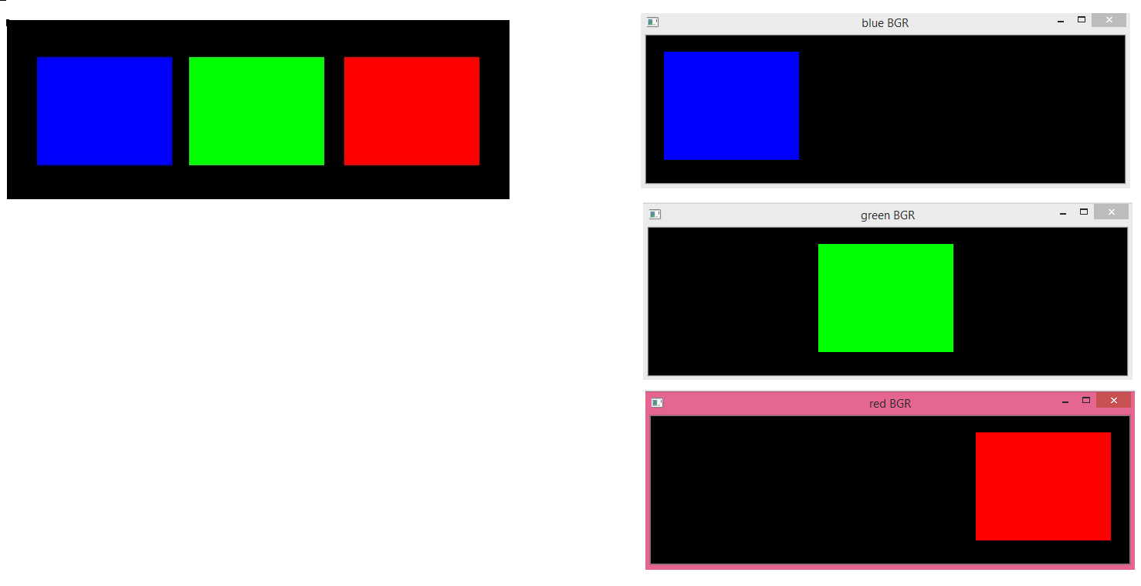
How to split image into Channels?
It consists of 3 rectangles, one in Blue (B=255, G=0, R=0), one in Green (B=0, G=255, R=0) and another in Red (B=0, G=0, R=255). The background is black (B=0, G=0, R=0).

Slide 31
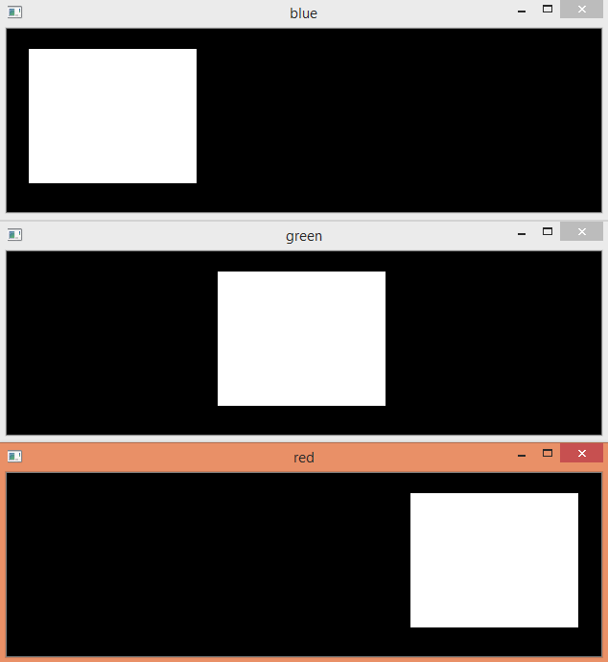
How to split image into Channels?
# splitting image into channels
img = cv2.imread(‘ BGR.jpg')
blue, green, red = cv2.split(img)
# plotting channels individually
cv2_imshow(blue)
cv2_imshow(green)
cv2_imshow(red)
cv2.waitKey(0)
cv2.destroyAllWindows()
Notes:
Source: Python OpenCV: Splitting image channels – techtutorialsx

Slide 32
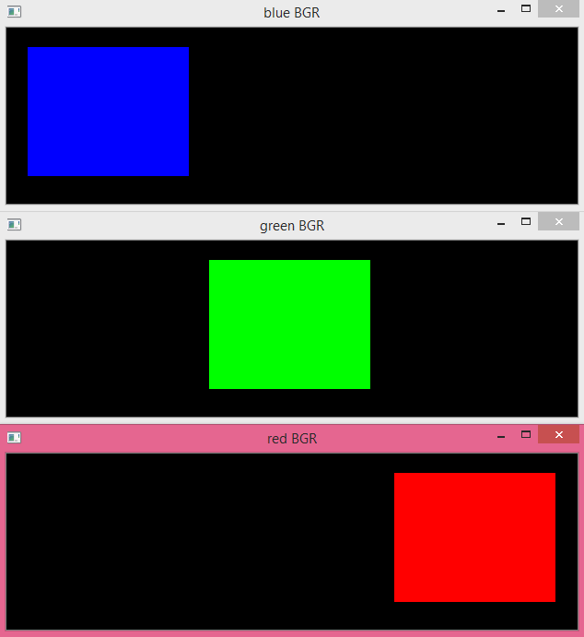
How to split images into Channels?
#Creating blank channels with shape as that of the image
zeros = numpy.zeros(blue.shape, numpy.uint8)
# merge blank channels with each grayscale channel to get the desired results
blueBGR = cv2.merge((blue,zeros,zeros))
greenBGR = cv2.merge((zeros,green,zeros))
redBGR = cv2.merge((zeros,zeros,red))
# display images
cv2_imshow(blueBGR)
cv2_imshow(greenBGR)
cv2_imshow(redBGR)
cv2.waitKey(0)
cv2.destroyAllWindows()

Slide 33
Activity
Open the GOOGLE COLAB notebook file (shared on the Moodle) AND PRACTICE

